Slide 1


CAREER COUNSELING PRESENTATION
Lekeesha
CNL 525
Figure 1. wiipa.org (n, d)

Slide 2

BASIC DEMOGRAPHICS
Twenty-Seven Years Old
African American
Female
Recently Widowed
Single Parent of Two Young Children
Strong Religious Faith
Graduate of Spelman College
Notes:
Lakeesha is a twenty-seven-year-old African American woman who was widowed six months ago. She is raising two young children by herself. Lakeesha is a graduate of Spelman College. Her major, minor, and degree type is unknown. She is a woman of strong faith, and her church group has been very supportive. She believes God will open a window of opportunity if she seeks his guidance. A strong religious foundation can promote resilience and comfort. During her first six months of grieving, her church members cared for the children and supported her. There is no further information about her children in regard to gender and age.

Slide 3



Career Development Thus Far
Graduated from Spelman College
Stay-at-Home Mom
Figure 3, www.Yes.org
Notes:
Lakeesha is an alumnus of Spelman College. She has the work ethic and intelligence to complete a degree. She also has the common sense to seek help with making a career plan. Not too much more information is offered about her career development. She does show signs of resiliency and mental strength to push through in difficult times. She has demonstrated a strong ability for organizational skills while managing the household for many years. Lakeesha also demonstrates forethought and planning by understanding the insurance policy is not going to last forever. Her faith is also a testament of her conforming nature.

Slide 4

Reason for Seeking Career Counseling
Internal Reasons:
Grief for loss of husband
Financial Security
Sole provider for children
Desire to start a career
Discover the Path God is Providing for Her
External Reasons:
Having limited funds
Explore career options
with the help of a
career counselor
Notes:
The internal reason that Lakeesha is seeking a counselor is to help her deal with the grief and loss of her husband. She wants to provide financial security for herself and her children. She is also processing the idea that she is the sole provider of her children's financial, mental, and rearing. She desires to find a career and discover the path God is providing for her. The external reason Lakeesha seeks career counseling is because she has limited funds and wants help making efficient career decisions. Having validation and guidance will help motivate her and increase her self-esteem, which will help her overcome obstacles.

Slide 5


UNIQUE PROBLEMS THAT MAY INFLUENCE COUNSELING
African American Women
Grieving Loss of Husband
Sole Financial Support
Single Parent
Notes:
Lakeesha has many stressors. She is an African American woman who will soon be entering the workforce. I would focus on finding diverse companies for her to apply to. She has no known disabilities however if she did I would connect her with community resources specializing in the disabled. The economic problems are not completely identified; however, I would provide information on programs like WIC, St Mary’s Food Bank, and Club 100, which sells reduced food boxes and children’s clothes. ST. Vincent De Paul also would be able to provide a source of sustenance. mental health problems, and cultural considerations. She will need to work through her issues with grief. She will need much encouragement and a nonjudgemental listener to help her gain self-confidence and devise a plan that includes financial assessment and exploring community resources. For example, she may qualify for scholarships to pay for additional schooling. I would teach relaxation techniques like breathing exercises. I would need to know how she wants to proceed. Is the life insurance income adequate financial support to enable her to pursue the necessary training? Once we figure that out, we can proceed to explore her interests.

Slide 6


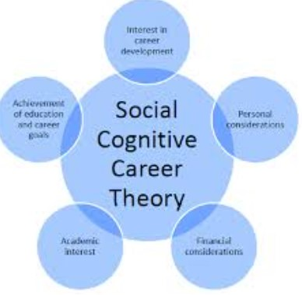
Social Cognitive Career Theory (SCCT) and Major Concepts
Self-Efficacy Beliefs
Outcome Expectations
Goal Setting
Figure 4 (n.d.)
Notes:
Self-efficacy beliefs: Lakeesha has demonstrated her ability to perform specific tasks as a homemaker
Outcome expectations: She has a positive outlook and is researching possible outcomes of her pursuits.
Goal setting: Lakeesha is very motivated to make her career successful for her children’s sake.

Slide 7


Information Needed for the Initial Assessment
Questionnaire
Testing
Education
Support
Figure 5. Unsplash (2024)
Notes:
An Intake Questionnaire should provide information about Lakeesha’s overall mental health and what she wants to receive from career counseling.
Super’s personality inventory should be completed to understand her personality type and likes and dislikes of her environment.
Evaluation of education achieved and what education is needed.
And finally, support in the form of encouragement and accountability

Slide 8


Steps in Career Development
Self-Assessment
Exploration
Testing Interests, Aptitude, and Availability
Figure 6 (n.d.)
Notes:
Career Development Lakeesha is career change since her husband passed away. Lakeesha is exploring new opportunities and has indicated she is excited about the challenge. Her first step was to seek career advice. Her responsibilities in household management, childcare, and college degree are things she can build on professionally. Self-assessment is the first step in career development process. Exploration is the second step and includes administering research, for example, utilizing vocation library assets, to get some answers concerning your professions of interests.Reality TestingImplementation

Slide 9
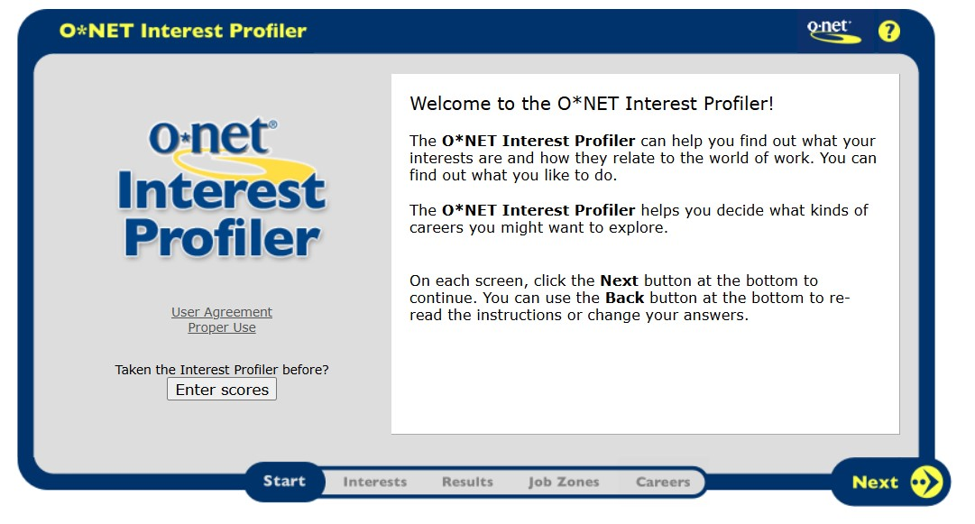
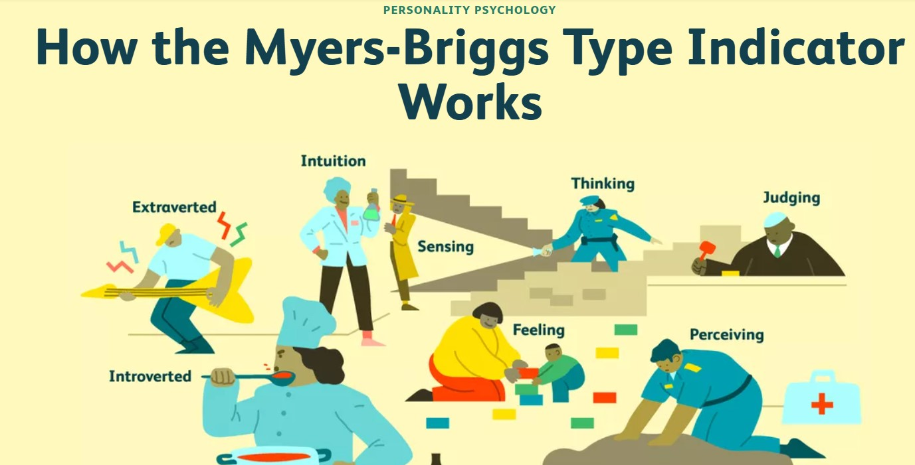
Career Resources & Assessments/Tools
O-Net Interest Profiler
Meyers Briggs Type Indicator
Figure 7.ONET.Org (2024)
Figure 8.verywellmind.com (2024)
Notes:
The O-Net uses the Strong Interest Inventory (SII) Online, which has many careers, to evaluate what positions you would be most interested in. Once the area of interest is determined, there are descriptions of the jobs that would suit your preferences. The Myers-Briggs Type Indicator(MBTI) analyzes a person’s personality and categorizes the individual into one of sixteen profiles. This provides better insight into how a person interacts with other personality types.

Slide 10


Application of Ethical Principles and Standards
Ethical Principle:
Do No Harm
NCDA Code of Ethics:
Respect the dignity of the Client
Informed Consent
Ethical principle:
Do No Harm
Figure 9. www.Istockphoto.com
Notes:
The primary responsibility of career development professionals are to respect the dignity and to promote the welfare of the individuals to whom
they provide service.
Informed Consent in the Professional Relationship. Clients have the freedom to choose whether to enter into or remain in a professional relationship.

Slide 11


Referral
Clinical Counseling
Group Counseling
Figure 10 troy.edu (2022)
Figure 11 troy.edu (2022)
Notes:
I would recommend continued clinical counseling to help cope with stressors that will surface while establishing her career and navigating through grief. Also, a grief counseling group could excel Lakeesha’s healing.

